Slide 1

Monkeypox: just another virus, or something to be concerned about?
Thomas McCane

Slide 2
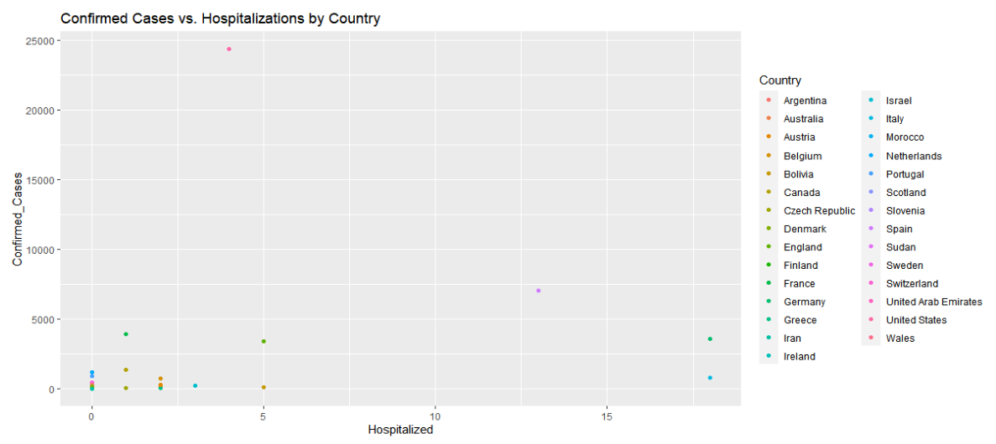
Confirmed Cases and subsequent hospitalizations
Color coded by Country
Not intended to show correlation, Visualization of data used.

Slide 3
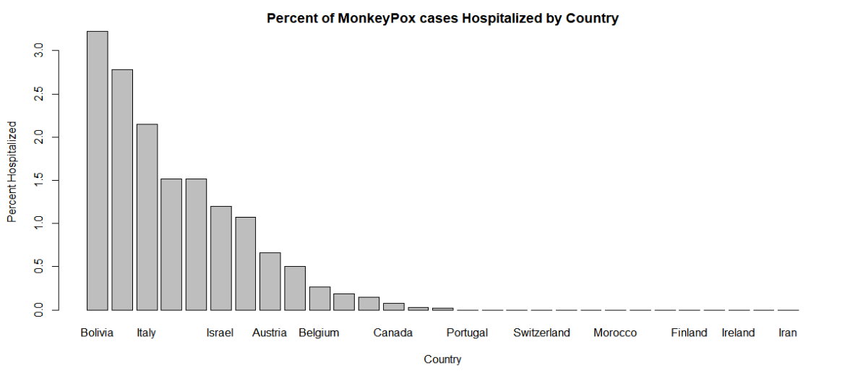
Confirmed Cases and subsequent hospitalizations, continued
Bar chart more closely detailing the ratio/percentage of hospitalizations to total case count
Mutate() function utilized to create a new column of percents in dataframe Monkey_Pox
Descending order

Slide 4
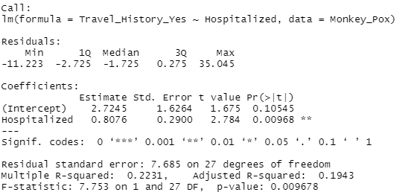
Regression analysis
p value of .009 shows a strong relationship (very high statistical significance) between hospitalizations and previous travel history

Slide 5
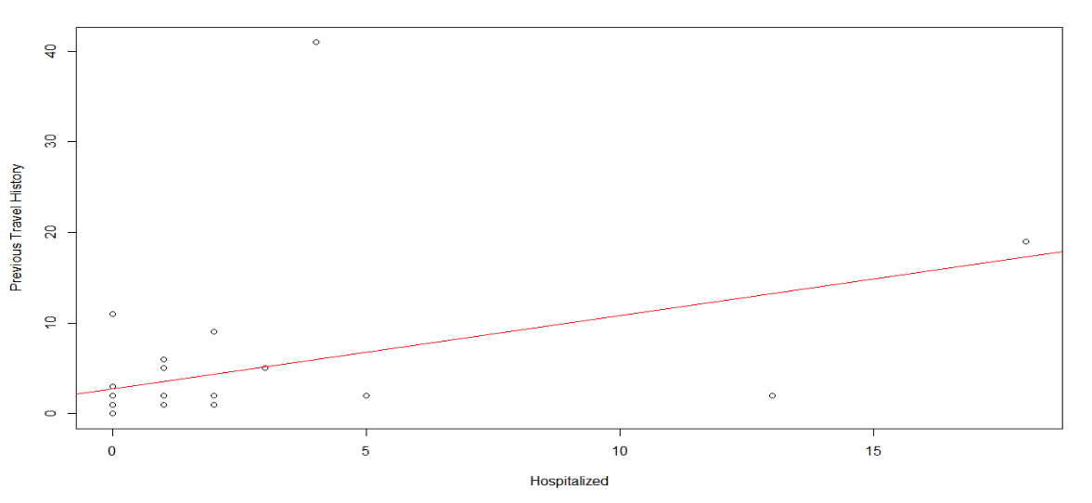
Regression plot

Slide 6
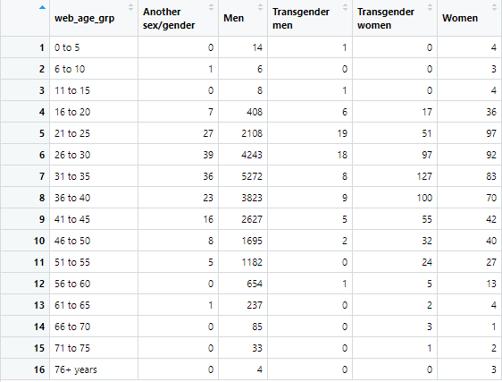
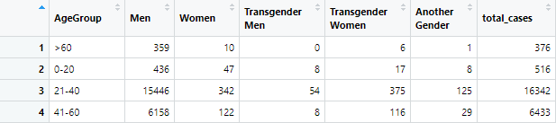
Reformatting of data to assess trends
Added and grouped columns and rows using case_when() and mutate() to breakdown the number of confirmed cases by age group and gender

Slide 7

Comparing means
Using more broad dataset to compare gender and confirmed cases.
P value of .808 is very high, very little differentiation of means, if any.
Limitations within dataset; findings not valuable to scope of analysis
Genders associated to case count in this dataset were not case by case, but rather input as majority

Slide 8
conclusions
Virus is still in its infancy- most current predictions are speculation based on other diseases in history and the limited data we have
Can confidently deduce that the current state of the virus is far less dangerous than that of covid, and transmission rates are very low
Variables like gender, age, and travel history are all important and relevant factors to consider in the spread of this virus despite its very recent onset
Countries notorious for poor disease prevention and management (e.g Italy, Greece, Bolivia and their struggles with Covid-19) have seen higher rates of hospitalizations and death
Men, especially middle aged, and those that have travelled around time of contraction are significantly more at risk.

